Slide 1
Lesson 0: Introduction and Example
Notes:
I want to give an idea for complexity then work backwards.

Slide 2
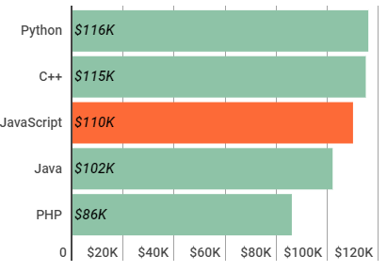
Why use Python?
Organization of data types and functions.
Contribution of open source community.
  Open source packages have been mature for some time and continue to improve.
Bonuses:
  Nice syntax.
  Glue language.
  Relatively easy to learn.
  Workflow is fantastic.
Cons:
  Slow, but turns out that is okay.
Notes:
Indeed will disagree with stack overflow take these stats with grain of salt.

Slide 3
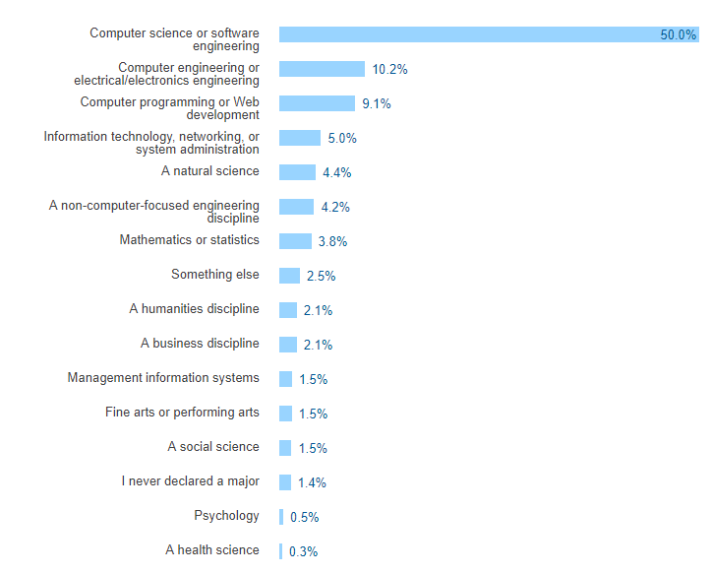
Health sciences are needed…

Slide 4
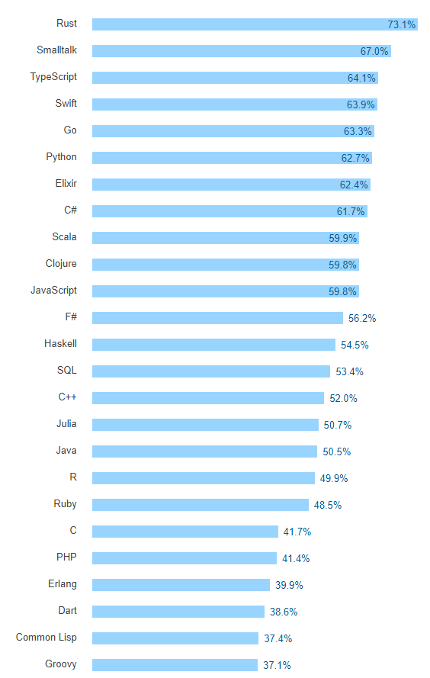
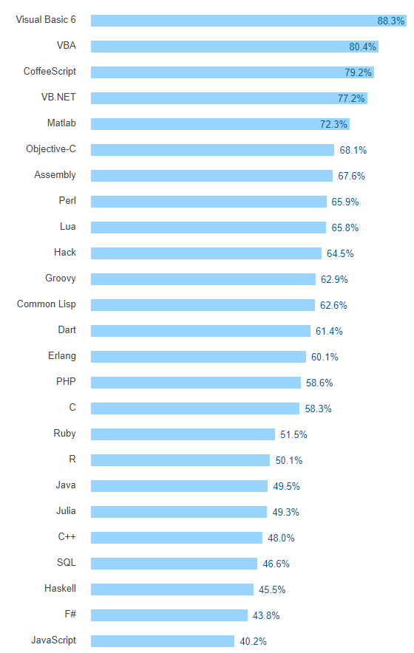
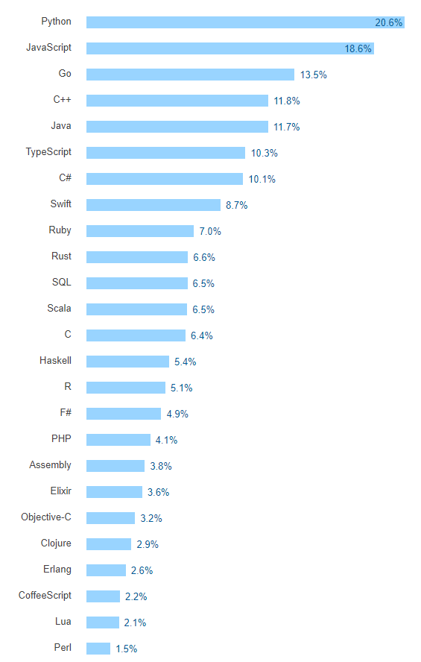
Most Loved Languages
Most Dreaded Languages
Most Wanted Languages

Slide 5
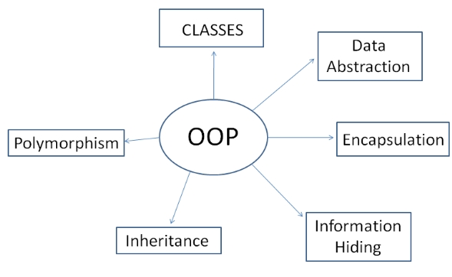
Python is a lot like other languages though…
Concepts transfer.
Most important concept will be Object Oriented Programming. (OOT)
Java, JavaScript, Ruby, C#, C++, and most others are completely or largely influenced by OOP.
Encapsulate and organize logic instead of making everything available.
Notes:
Get to this later. I want to avoid theory.

Slide 6
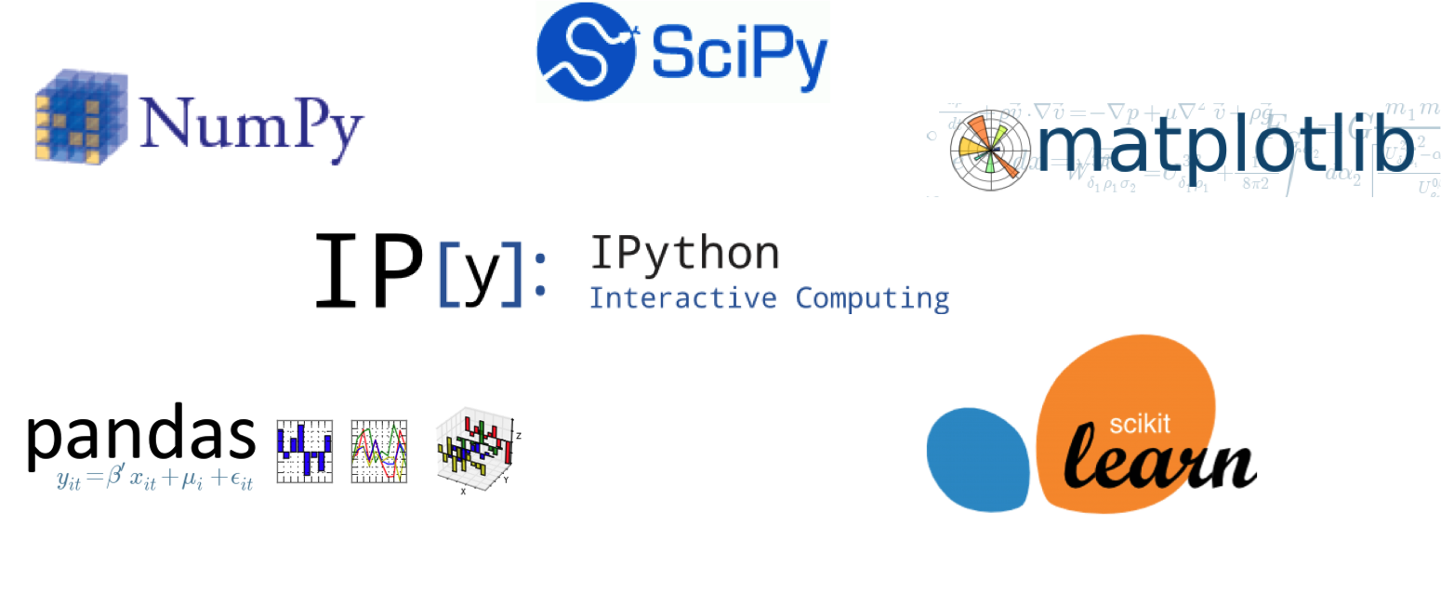
How does this help with data science?
Packages use OOP to organize code.
Understanding OOP makes it easy to find and understand documentation.
Simplifies general concept. “Everything is an object” reduces some complexity.
Notes:
All these packages use objects to encapsulate their datatypes.

Slide 7
Let’s look at a finance example

Slide 8
What’s with the MoneyTracker object?
Provide a method that initializes the object, __init__
Allow the object to be called with new data, updating the state and returning the current earnings ratio.
Every piece of data in Python is an object that works like this.
$10
Feed in price
Update State
MoneyTracker
(Decide to buy or sell)
Return the current earnings state.
1.12
Notes:
Consider a musical note, a person, employee, an array of numbers, a view on a webpage, an animation, a graph, a player in a video game, etc.
We will make this more clear later, but it will pay dividends now to think of every piece of data as an object in some respect.

